Slide 1
Chapter 9
The use of Budgets in Organisations

Slide 2
Objectives
After studying this topic you should be able to:
explore the development of budgeting
consider the role of budgets within organisations
develop budget preparation skills
consider the behavioural implications of budgeting
evaluate the use of budgets in contemporary business environments

Slide 3
The Relationship between long-term and short-term budgeting

Slide 4
The role of budgets
Planning
Control
Measure performance
Communication
Coordination
Motivation

Slide 5
Master budget preparation
Should the budget be prepared for a fixed financial year, or be a rolling budget?
Is the best approach ‘top-down’, or ‘bottom-up’?
Do we need a budget committee or a budget manual?
Should we use a fixed or flexible budget?
Should an incremental or zero based approach be used?

Slide 6
Limiting Factors
Capacity
Customers
Labour
Management
Capital

Slide 7
Classification of Budgets

Slide 8
Cash Budgeting
A cash budget gives a useful overview of the inflow and outflow of cash in the budgeted period. This can forewarn management as to when cash is short, when an overdraft needs to be arranged, etc. Equally, in times of plentiful cash short-term investments might be considered to keep the cash working for the business.

Slide 9
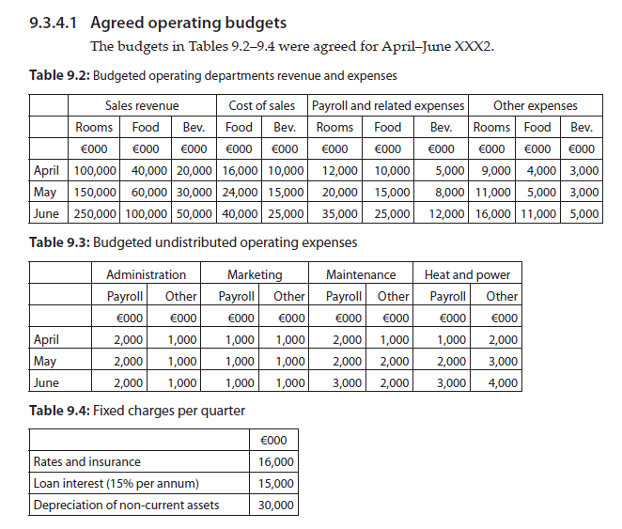
Budgeting Example (1)
See textbook for full details for the full example data

Slide 10
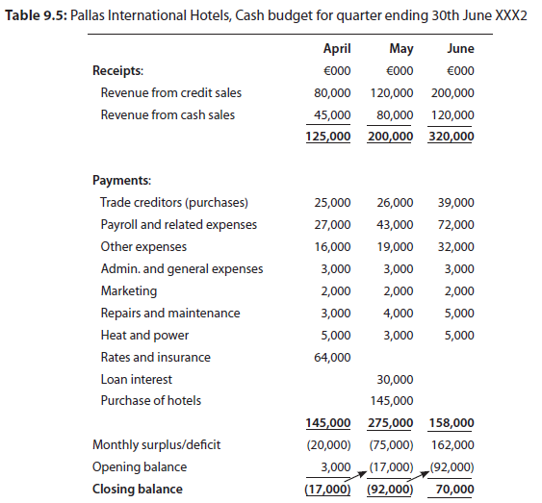
Budgeting Example (2)
See textbook for full details for the full example data

Slide 11
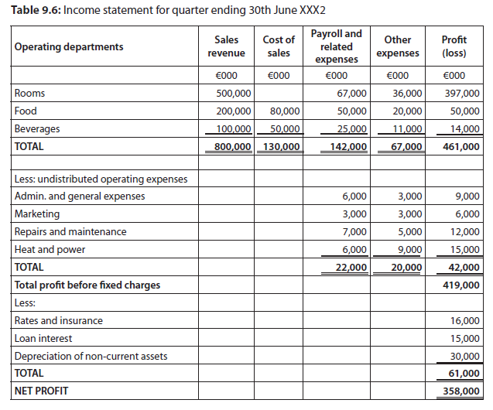
Budgeting Example (3)
See textbook for full details for the full example data

Slide 12
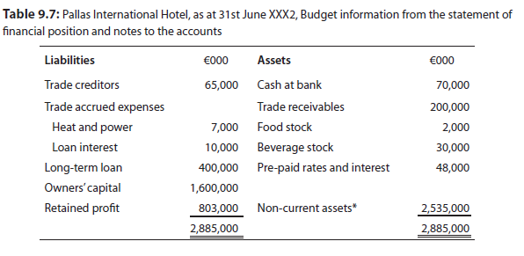
Budgeting Example (4)
See textbook for full details for the full example data

Slide 13
Budgetary control
Producing a budget can give many advantages, but it has to be a working document and utilised within the operation routinely to have a control function
It shows managers how they are doing in relation to the set targets
It gives information to where operational issues might exist to aid management in operational control of the business
This involves a comparison of budget to actual data to identify variances

Slide 14
Variances
Variances are always discussed in relation to their impact on profit. All else being equal, does the variance have an adverse (A) or favourable (F) impact on profit?
From a management perspective focus needs to be paid to ‘significant variances’.
Variance: | Impact on profit:
Revenue up | Favourable
Revenue down | Adverse
Specific cost up | Adverse
Specific cost down | Favourable

Slide 15
Sid's Spit Roast
Sid produces a budget and then compares this with the actual results:
 | Budget | % | Actual | % | Variance | %
Sales Revenue | £13,500 | 100% | £12,000 | 100% | £1,500 A | 11%
Food costs | £4,500 | 33% | £4,200 | 35% | £300 F | 7%
Gross Profit | £9,000 | 67% | £7,800 | 65% | £1,200 A | 13%
This does not answer all of Sid’s management questions though -
Why has the sales revenue gone down? – difference in sales volume, selling price, or both?
Why has the food cost gone down? – as a variable cost, is it still the same per unit, but we sold less? – is it the quantity of ingredients used (portion size)? – or the price per kg that has changed?
Clearly it is these questions that need to be answered, but to do this we need more information and to use a flexed budget to assist.

Slide 16
Flexed Budgets
Sid in his original budget planned to sell 3,000 units in reality he only sold 2,500 individual units – with this additional information a flexed budget can be used to give us far more information to analyse the situation.
 | Per unit | Original Budget 3,000 | Flexed Budget 2,500 | Actual 2,500 | Flexed to actual Variance
Sales Revenue | £4.50 | £13,500 | £11,250 | £12,000 | £750 (F)
Food costs | £1.50 | £4,500 | £3,750 | £3,800 | £50 (A)
Gross Profit | £3.00 | £9,000 | £7,500 | £8,200 | £700 (F)

Slide 17
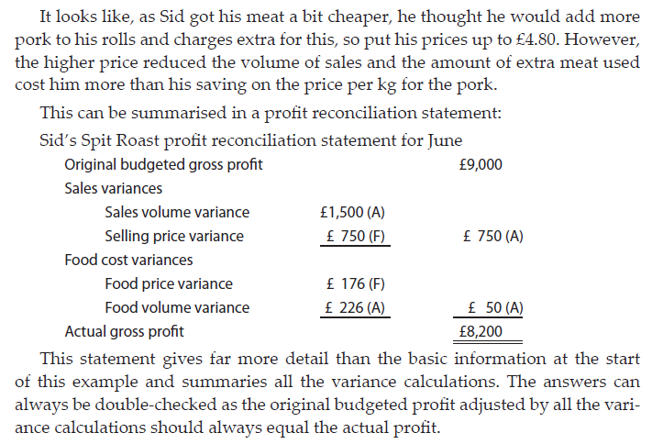
Reconciliation statement
Sid’s spit roast can calculate many individual variances from the flexed budget, as detailed on pages 134-136. These are then summarised in a profit reconciliation statement.

Slide 18
Responsibility accounting
Cost Centers
Revenue Centers
Profit Centers
Investment Centers

Slide 19
Transfer pricing
Goods and services transferred between divisions have to be priced so that the supplying division gets the credit; this then becomes a cost to the receiving division.
A transfer price may be set at cost, or include some form of profit – examples include a transfer price at variable cost, full cost, cost plus profit, market price, or a negotiated price.

Slide 20
Beyond budgeting/better budgeting – Problems of traditional budgets (1)
The change of pace in business – can we any longer produce a fixed budget for a year ahead, given rapid changes in the world we need to react to?
Budgets restrict entrepreneurial risk taking – this could have a negative impact on long term business growth.
Budgetary control can be inward looking – the external issues in the market and comparative analysis of competitors are seen as vital in modern business.

Slide 21
Beyond budgeting/better budgeting – Problems of traditional budgets (2)
Traditional budgeting can lead to ‘budgetary gamesmanship’ – this can lead to managers actions that are not in the best long term interest of the firm as a whole.
Budgets are time consuming to produce – on a cost versus benefit basis are they valuable?
Departmental barriers can be encouraged in budgets, often with competing targets – does this maximise the returns for the business as a whole?

Slide 22
Beyond budgeting
Beyond Budgeting believed firms should move ‘beyond budgets’ and look for alternative ways of planning and control in organisations.
See www.bbrt.org for the positive view of moving beyond budgeting

Slide 23
Better budgeting
Better budgeting view traditional budgets could be adapted to meet the needs of modern industry.
The CIMA 2004 report gives many views on budgeting, better budgeting & beyond budgeting (reference on p145 in textbook)

Slide 24
Summary
Budgets have existed for over a century within organisations.
Budgets have many roles, including aiding; planning, control, performance measurement, communication, coordination, and motivation.
There are a number of limiting factors when budgeting such as; physical capacity, customer demand, labour availability, management ability, or capital available.
A master budget combines all individual operating and capital budgets.
Cash is the life blood of an organisation, so the cash budget is an important document in addition to the income statement and statement of financial position.

Slide 25
Summary
Being able to identify ‘significant’ variances is an important aspect of budgetary control.
Flexed budgets aid control when the sales volume is not as predicted in the original budget.
Responsibility accounting aids the ability to match financial statements to the individual elements a specific manager is responsible for and has the ability to influence/control.
Beyond budgeting and better budgeting are alternative ways of overcoming weaknesses with traditional budgeting.
Beyond budgeting is not a method of budgeting, it is an alternative that does not use a budget.

